Slide 1
CC2 PRESENTATION
GROUP 11 SUH
SUPERVISOR – SURESH S SAMINATHAN

Slide 2
GROUP 11
MEMBERS:
ABDULRAHMAN GAMIL MOHAMMED AHMED .
BALKAN DOVRANOV .
DARRSHAN RAAJ A/L VIKNESWARAN .
DARSHRNNEY A/P PUSHPANATHAN .
FAISAL IMTIAZ .
LEE TECK KUAN .
LENNARD THENG ZHENG ZHE .
LOH WEI LOON .
LUBAINA ABDULLAH KHAN .
NICHOLAS HARTONO PUTRA .
SAM ZHENG XUAN .
TAN JIE SHEN .
TAN YEE .
WESLEY .
YOUSIF MOHAMED ELEID ALI SID AHMED .

Slide 3
GOALS & OBJECTIVES
1- The primary objective is to inform attendees about Malaysia's history, culture, and legacy.
2- Participants will obtain a deeper grasp of Malaysia's distinct culture while also having fun.
3- interact with like-minded people and bring community members together.
4- A chance for guests to socialise and participate in the environment.
5- Spreading information, celebrating culture, engaging with one another, and raising money are the overall objectives.

Slide 4
LOG OF ACTIVITIES : Pre-Event:
- PLANNING PROPOSAL
DATE | ACTIVITY | Description
16 March | Online Group Chat Discussion | - Making a group chat on teams - Discussing the project we are going to do - Deciding on the group name Made Google Forms to find target audience
23 March | Online Teams Meeting | - Deciding on which museum to go - Dividing task - Discussing the event
3 April | - Online Group Chat Discussion | - Discussing the time to carry out the event Decide target audience from google form results
4 April | - Online Teams Meeting | - Elaborating more on the key personnel and task
14 April | - Online Teams Meeting | - Presentation on the event proposal with supervisor - Discussion regarding the bus

Slide 5
- PLANNING EVENT
DATE | ACTIVITY | Description
15 April | Online Group Chat Discussion | - Discussing about the fees and budget
30 April | Online Group Chat Discussion | - Discussing the time to carry out the event and how to promote - Making forms
6 May | - Online Teams Meeting | - Discussing about promotion, participant’s drinks, poster, quiz - Making QR code
9 May | -Online Group Chat Discussion -Marketing Commencement | - Making Instagram account for promoting the event - Finishing the quiz
10 May | - Online Group Chat Discussion | - Discussing about the booking the bus
12 May | -Online Group Chat Discussion | - Final decision on setting the date of carrying out the event
27 May | -Online Group Chat Discussion | - Purchasing buns and prize for quiz - Discussing about the number of people joining the event

Slide 6
IMPLEMENTATION
Event Day (28th May)
Time | ACTIVITY
10:00a.m. - 10:30a.m. | - Gathering Participants at APU lobby -Waiting for Bus
10:30a.m. - 11:00a.m. | -Depart to Museum Negara
11:00a.m. - 1:00p.m. | -Museum Tour
1:00p.m. - 1:30p.m. | -Gathering Participants for Group Photo -Waiting for Bus to head back
1:30p.m. - 2:00p.m. | -Depart back to APU -Give out Quiz -Give out the prize for the winner of Quiz

Slide 7
POST-MORTEM
DATE​ | ACTIVITY​ | Description​
28 May | Earnings Calculation | - Calculating the money acquired Calculating the expenses and profits acquired
31 May | - Online Group Chat Discussion | -Dividing tasks for report -Individual Reflection Writing
15th June | - Online Group Chat Discussion​ | -Presentation Slides Making
20th June | -Online Group Chat Discussion ​ | - Video Recording for Individual Reflection
30th June | - Online Teams Meeting​ ​ | - Online Presentation

Slide 8
TASK DIVISION
2.1 DIVISION OF TASK
MEMBER NAME | TASK ALLOCATED
ABDULRAHMAN GAMIL MOHAMMED AHMED | -Minutes of meetings. - Arrange the meetings. - Attend the event. - Direct the participants.
BALKAN DOVRANOV | - Contacting Muzium Negara in order to get information no tickets, their working dates, is our trip possible and if we need to take care of additional things (with Darrshan) - Helping with the marketing
DARRSHAN RAAJ A/J VIKNESWARAN | - Calling the museum to ask about prices - Gathering sponsors for food and drinks - Photography on event day - Attend the event.

Slide 9
2.1 DIVISION OF TASK
MEMBER NAME | TASK ALLOCATED
DARSHRNNEY A/P PUSHPANATHAN | - Registering participants -Collecting money from participants -Creating the google form - Making sure we are on schedule -Giving all the information to the participants (By directing them , making a group chat , answering any questions they had, etc.) - Writing report: (Appendices) -Advertise thru Microsoft Teams (APU ) - Attend the event.

Slide 10
DIVISION OF TASK
MEMBER NAME | TASK ALLOCATED
FAISAL IMTIAZ | Trip Idea Poster Advertisement(thru Instagram) Managing and keeping track of Students. - Attend the event.
LEE TECK KUAN | Making a Gantt Chart Making Presentation of Report Attend the event
LENNARD THENG ZHENG ZHE | - Creating Timetable - Making Quiz
LOH WEI LOON | - Made Google Form to select targeted audience for promoting - In charge of marketing/promoting - Made Instagram account to promote - Attend the event -Finalizing Log of Activities
LUBAINA ABDULLAH KHAN | -Doing the initial budget(idea) - Attend the event.

Slide 11
DIVISION OF TASK
MEMBER NAME |  | TASK ALLOCATED
NICHOLAS HARTONO PUTRA | TP067308 | - Making the proposal - Making Budget - Making ppt file for proposal presentation - Booking consultation - Calculate the profits gained - Gather data on money spent - Making Log of Activities - Making Abstract - Making template for task division and key personnel - Making outcome and recommendation - Advertise the event through chat - Making key personnel diagram - Make QR code for registration - Attend the event

Slide 12
DIVISION OF TASK
MEMBER NAME |  | TASK ALLOCATED
SAM ZHENG XUAN | TP070497 | - Design the Event Poster - Transportation Detail Consult - Optimizing the Google Form(ideas) - Creating Social Media Account - Poster Advertisement - Finding sponsors - Optimizing the outcomes and recommendations
TAN JIE SHEN
TAN YEE |  | - Making Quiz - Buying Prize
WESLEY |  | - Arranging bus transportation - Making up schedule - Attend the event.
YOUSIF MOHAMED ELEID ALI |  | - Attend the event.

Slide 13
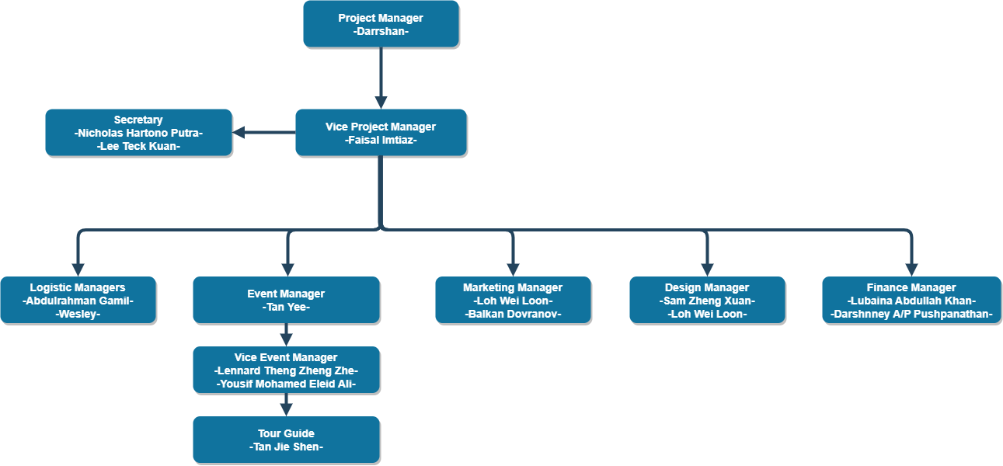
TASK DIVISION
2.2 KEY PERSONNEL

Slide 14
OUTCOME
a valuable learning experience.
not allocating tasks to members properly due to lack of communication
ambiguity in deciding the date to hold our event.
finding a common time to have a meeting.

Slide 15
RECOMMENDATIONS
Improving communication by writing down the conclusions of our meeting and listing out the issues in our teams' group.
implement a structured task assignment system and correctly assign roles.
diversify the activities.

Slide 16
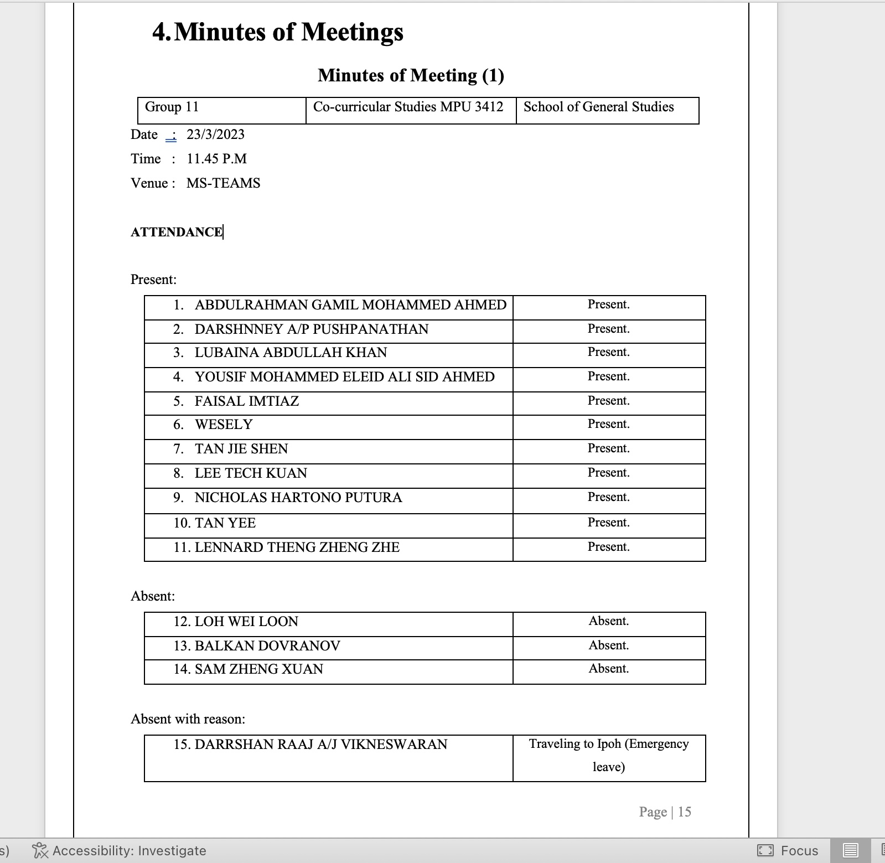
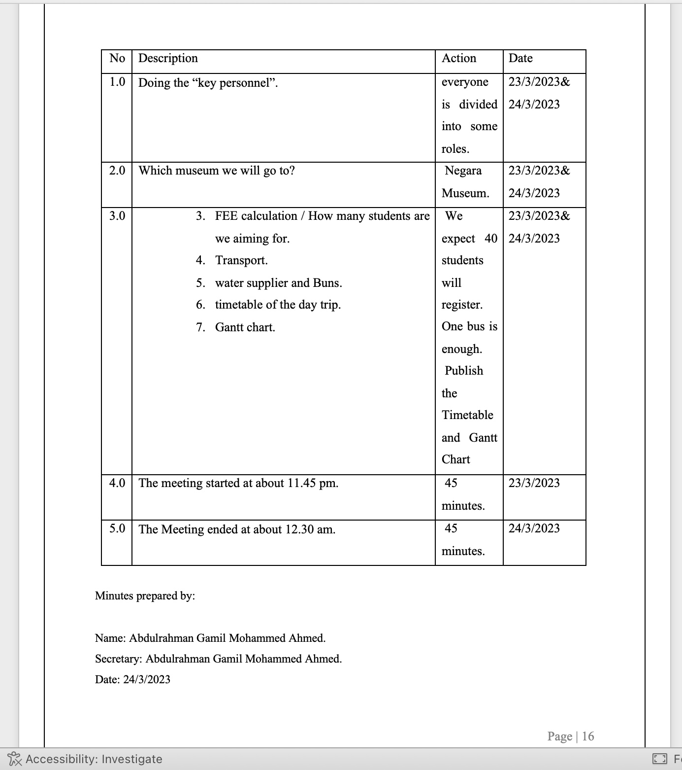
MINUTES OF MEETINGS

Slide 17
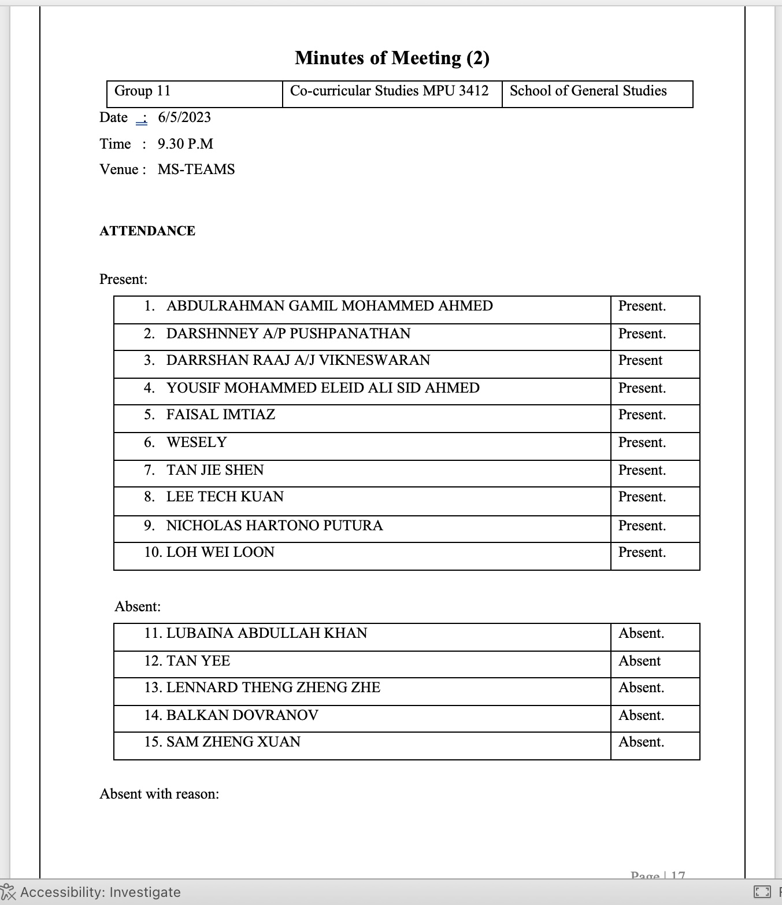
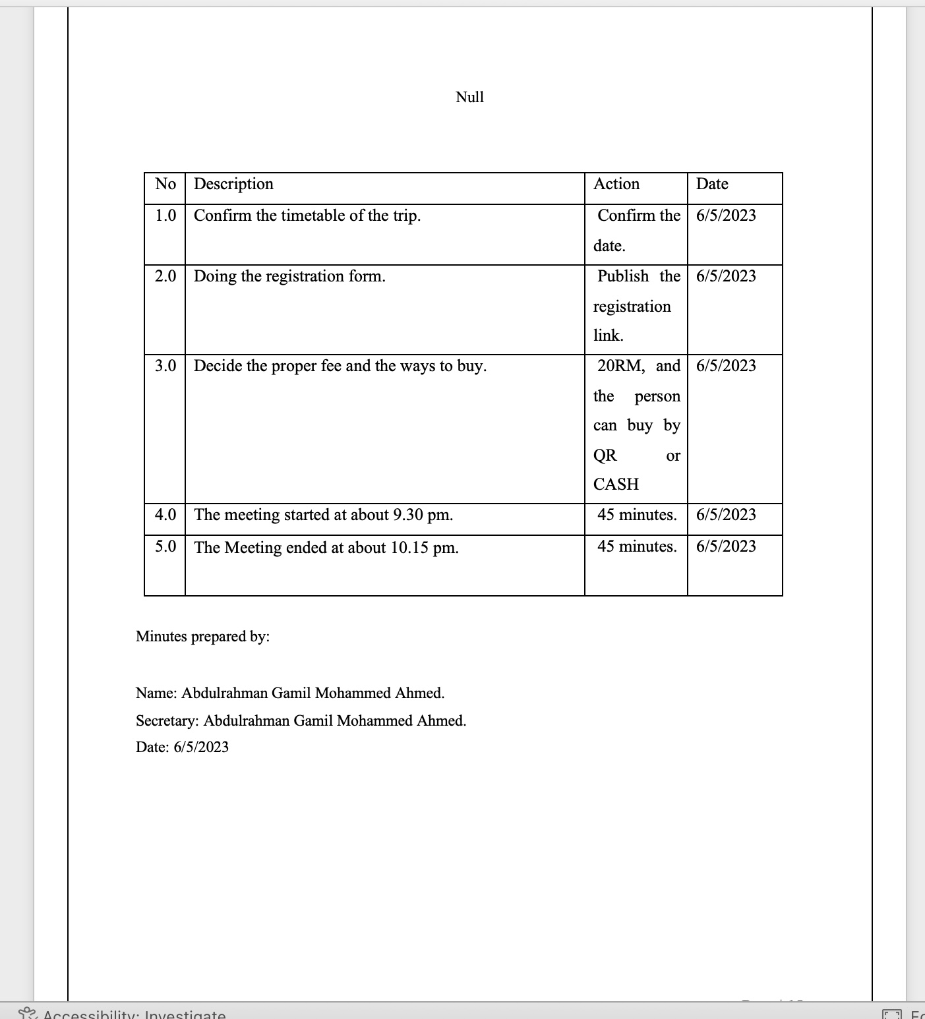
MINUTES OF MEETINGS

Slide 18
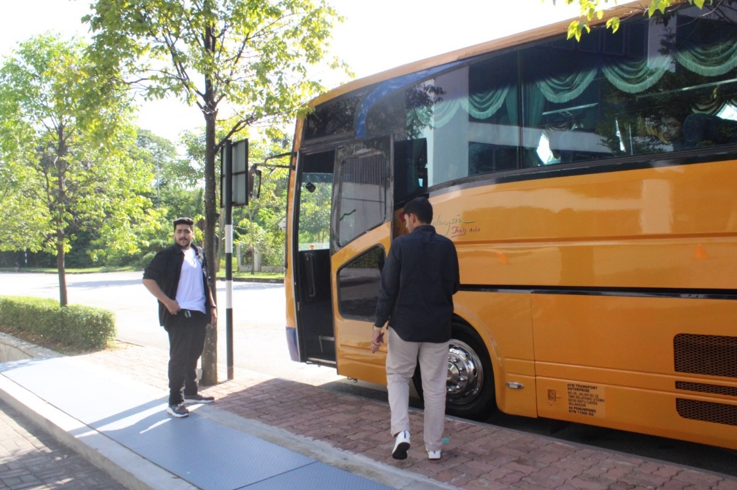
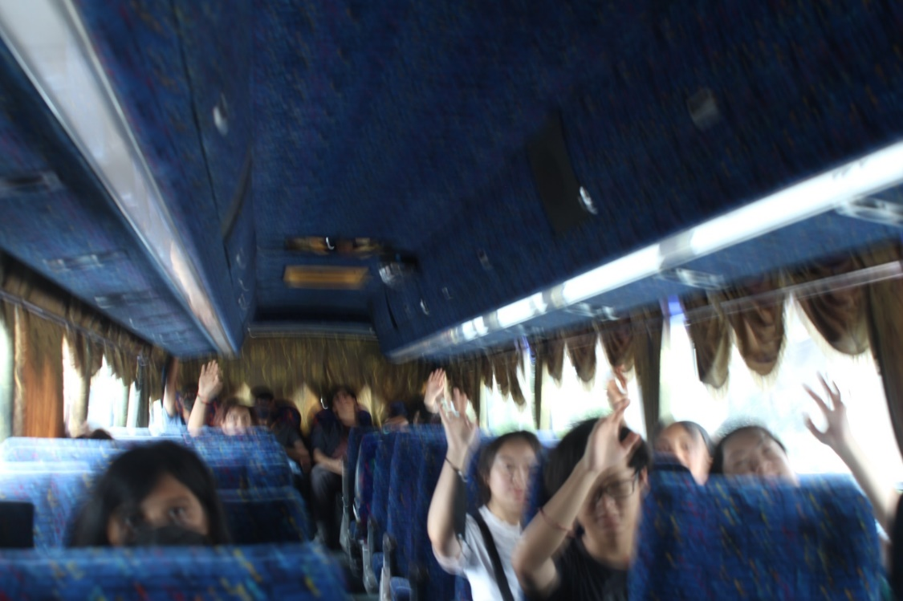
APPENDICES

Slide 19
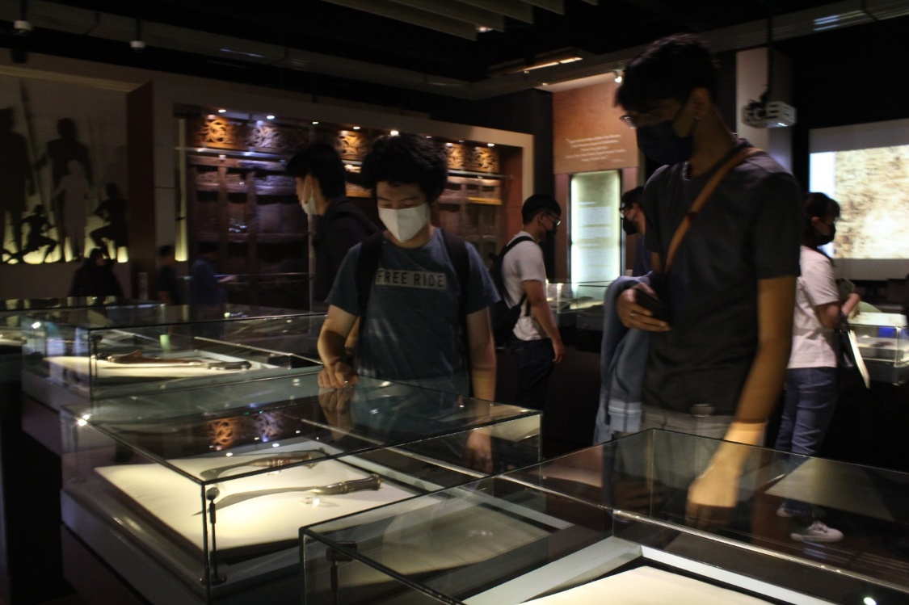
APPENDICES

Slide 20
SELF REFLECTIVE ESSAY ABDULRAHMAN GAMIL
skills relevant to my future
teamwork
time management and organizational skills
skills learnt during the project
communication skill
having trust in other people

Slide 21
SELF REFLECTIVE ESSAY BALKAN DOVRANOV
skills learned during the project
formal mailing
things happen
skills relevant for my future
communication
teamwork

Slide 22
SELF REFLECTIVE ESSAY DARRSHAN RAAJ A/J VIKNESWARAN
Skills learnt during the project
Communications skills
Time Management
Skills relevant to my future
Photography
Teamwork

Slide 23
SELF REFLECTIVE ESSAY DARSHRNNEY A/P PUSHPANATHAN
skills learnt during the project
organzing skills
obsevation skills
skills relevant to my future
critical thinking and problem solving skills
digital literacy skills

Slide 24
SELF REFLECTIVE ESSAY FAISAL IMTIAZ
skills learnt during the project
managing a group of 20 to 30 students
multitasking
skills relevant to my future
1. communication and management skills
2. process of organizing events

Slide 25
SELF REFLECTIVE ESSAYS LEE TECK KUAN
Skills learnt during project
Communication
Planning a Project
Skills relevant for my future
Time Management
Divide of Labor

Slide 26
SELF REFLECTIVE ESSAY LENNARD THENG ZHENG ZHE
skills i learnt during the project
research skills
adaptibility
skills relevant for the future
cultural awareness
strategic thinking

Slide 27
SELF REFLECTIVE ESSAY LOH WEI LOON
skills learnt during project
Teamworking skills
Planning skills
skills relevant for the future
marketing skills
communication/social skills

Slide 28
SELF REFLECTIVE ESSAY LUBAINA ABDULLAH KHAN
skills i learnt during the project
teamwork skills
creativity skills
skills relevant for my future
social skills
management skills

Slide 29
SELF REFLECTIVE ESSAY NICHOLAS HARTONO PUTRA
skills learnt during the project
business documentation and presentation skills
communication skills
skills relevant for my future
time mangament
teamwork

Slide 30
SELF REFLECTIVE ESSAY SAM ZHENG XUAN
skills learnt during the project
teamworking
listening skills
skills relevant for my future
communication skills
conflict resolution skills

Slide 31
SELF REFLECTIVE ESSAY TAN YEE
skills learnt during the project
research skills
event planning
skills for my future
problem solving
time management

Slide 32
SELF REFLECTIVE ESSAY WESLEY
skills learnt during the project
prepare effective plan
communication skills
skills relevant for my future
effective planning
effective collaboration

Slide 33
SELF REFLECTIVE ESSAY YOUSIF MOHAMED ELEID ALI

Slide 34
THANK YOU

